Slide 1
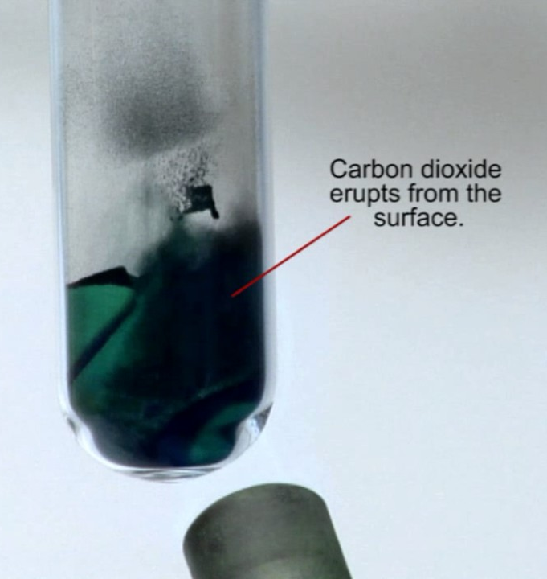
Daily Review
Writing Word Equations
Identify the reactants in the reaction and write them first, with plus signs between each one
Write an arrow at the end of the reactants
Identify the products in the reaction and write them after the arrow, with plus signs between each one
Copper carbonate decomposes into carbon dioxide and copper oxide when it is heated.
Copper carbonate
Carbon dioxide + Copper oxide
→

Slide 2

Daily Review
Writing Word Equations
Identify the reactants in the reaction and write them first, with plus signs between each one
Write an arrow at the end of the reactants
Identify the products in the reaction and write them after the arrow, with plus signs between each one
When iron rusts, it reacts with the oxygen in the air to form iron oxide.
Reactants
Iron + Oxygen
Products
Iron oxide
→

Slide 3
Daily Review
CFU 1
What does the formula for a chemical compound describe?
We use chemical formulae to show the types and numbers of atoms that make up molecules.
The element symbols tell us the types of atoms present.
The numbers written after the element symbols tell us the number of each type of atom present.
If there is only one atom of an element, no number is written.
The numbers are written as a subscript: a small number in front of and below the element symbol.
CFU 2
How can we tell what type of atoms are present in a chemical formula?
CFU 3
How can we tell how many atoms are present in a chemical formula?
Reminder:
Each new atom begins with a CAPITAL letter.

Slide 4
Daily Review
CFU 1
What does a chemical formula tell us?
We use chemical formulae to show the types and numbers of atoms that make up molecules.
CFU 2
Which elements and how many of each are in sodium oxide, Na₂O?
For example: the chemical formula for water is H₂O.
There are 2 hydrogen atoms in one water molecule.
There is 1 oxygen atom in one water molecule.
There are a total of 3 atoms in one water molecule.
CFU 3
Which elements and how many of each are in sulfuric acid, H₂SO₄?
Reminder:
Each new atom begins with a CAPITAL letter.

Slide 5
Conservation of Mass and Balancing Equations Year 9 Science

Slide 6
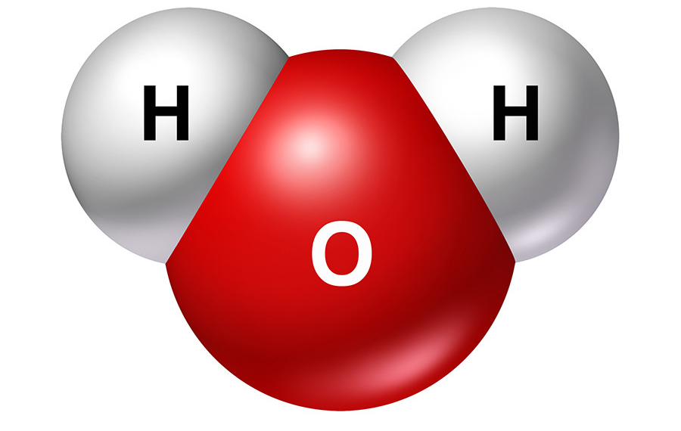
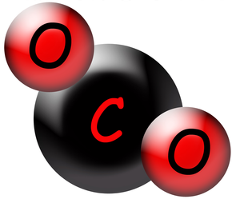
Learning Objectives
CFU
What we are learning about today?
Describe the Law of Conservation of Mass.
Balance simple formula equations.
Activate Prior Knowledge
On your whiteboard, write the chemical formulae for:
water and carbon dioxide
Think, Pair, Share: What does the chemical formula tell you about these compounds?

Slide 7
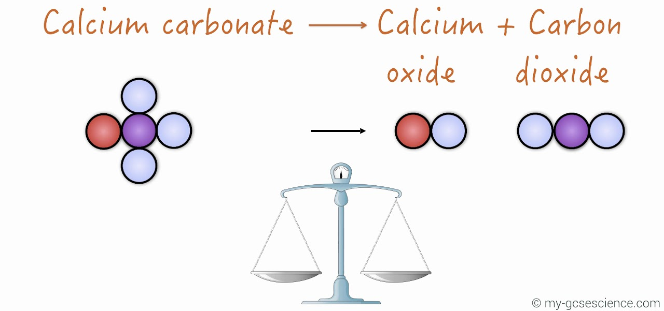
Concept Development
CFU 1
What happens to atoms during a chemical reaction?
Law of Conservation of Mass
When a chemical reaction takes place, the molecules in the reactants break apart.
The atoms then rearrange to form the products.
During this process, no new atoms are produced and no atoms are destroyed.
This is called the Law of Conservation of Mass.
CFU 2
In your own words, describe the Law of Conservation of Mass.

Slide 8
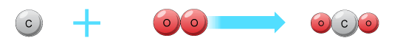
Concept Development
CFU 1
What are the two ways chemical reactions can be written?
Formula Equations
Chemical reactions can be represented using word equations, for example:
Carbon + Oxygen → Carbon dioxide
Chemical reactions can also be represented using chemical formulae (plural of formula).
This shows how many atoms of each element are present, for example the equation above can be written as:
C + O₂ → CO₂
CFU 2
What does the formula for carbon dioxide tell you about the elements in it and how many there are?

Slide 9
Concept Development
CFU 1
What makes an equation balanced?
Formula Equations
Mass is conserved in a chemical reaction.
The number of atoms of each element is the same before the reaction and after the reaction.
When the number of atoms of each element are the same before and after, the equation is balanced.
For example, the equation C + O₂ → CO₂ is balanced.
There is one carbon atom on each side and two oxygen atoms on each side.
CFU 2
Why is the number of atoms of each element the same in a reaction?
CFU 3
Is the equation below balanced? Explain why or why not.
H₂SO₄ + Na → NaSO₄ + H₂

Slide 10
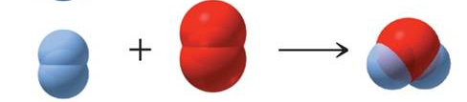
Concept Development
CFU 1
Explain the difference between a balanced and an unbalanced equation.
Formula Equations
When the number of atoms of each element are the not same before and after, the equation is unbalanced.
For example, the equation H₂ + O₂ → H₂O is unbalanced.
There are two hydrogen atoms on each side, but two oxygen atoms on the reactants side and one oxygen atom on the products side.
CFU 2
Which of the equations below is unbalanced? Explain your choice.
HCℓ + Mg → MgCℓ₂ + H₂ CuCO₃ → CuO + CO₂

Slide 11
Concept Development
CFU 1
How can we make an equation balanced?
Balancing Formula Equations
To balance an equation, a number is written before one or more chemical formulae.
This is called a coefficient.
The coefficient shows how much of each substance is needed.
2 HCℓ + Mg → MgCℓ₂ + H₂
The coefficient in front of HCℓ means there are 2 HCℓ molecules for each magnesium atom.
CFU 2
What does a coefficient show?
CFU 3
Rewrite the equation at the bottom of the slide. Put a circle around the coefficients and a box around the subscripts.
2H₂ + O₂ → 2H₂O

Slide 12
Concept Development
CFU 1
What does a coefficient do?
Balancing Formula Equations
The coefficient multiplies all the atoms in the substance by that number.
2HCℓ + Mg → MgCℓ₂ + H₂
The 2 in front of the HCℓ means there are now 2 hydrogen atoms and 2 chlorine atoms on the reactants side of the equation.
CFU 2
How many atoms of hydrogen are on the right side of the equation below?
CFU 4
How many atoms of oxygen are on the right side of the equation below?
2H₂ + O₂ → 2H₂O

Slide 13
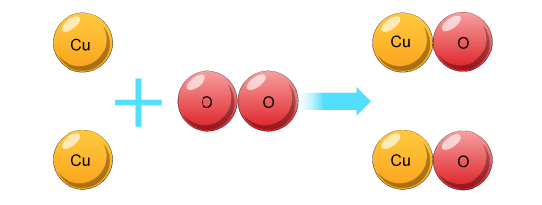
Skill Development / Guided Practice
Balancing Formula Equations
List the number of each type of element on both sides of the equation.
Choose an element that has unequal numbers
Add coefficients to make them equal and adjust the numbers of elements in the list.
Choose another element that has unequal numbers, add coefficients and adjust the list.
Continue until all elements have equal numbers.
Copper + Oxygen → Copper oxide
Cu + O₂ → CuO
2
2
Cu = 1
O = 2
2
Cu = 1
O = 1
2
2

Slide 14
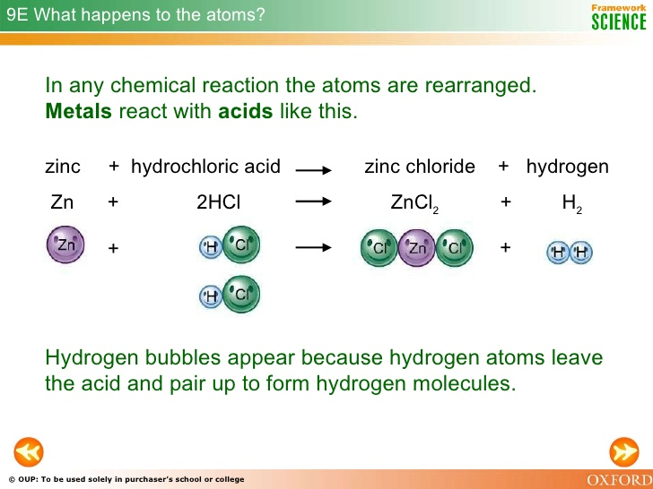
Skill Development / Guided Practice
Balancing Formula Equations
List the number of each type of element on both sides of the equation.
Choose an element that has unequal numbers
Add coefficients to make them equal and adjust the numbers of elements in the list.
Choose another element that has unequal numbers, add coefficients and adjust the list.
Continue until all elements have equal numbers.
Hydrochloric acid + Zinc → Zinc chloride + Hydrogen
HCℓ + Zn → ZnCℓ₂ + H₂
2
2
H = 1
Cℓ = 1
Zn = 1
H = 2
Cℓ = 2
Zn = 1
2

Slide 15
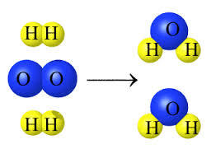
Skill Development / Guided Practice
Balancing Formula Equations
List the number of each type of element on both sides of the equation.
Choose an element that has unequal numbers
Add coefficients to make them equal and adjust the numbers of elements in the list.
Choose another element that has unequal numbers, add coefficients and adjust the list.
Continue until all elements have equal numbers.
Oxygen + Hydrogen → Water
O₂ + H₂ → H₂O
2
2
O = 2
H = 2
O = 1
H = 2
2
4
4

Slide 16
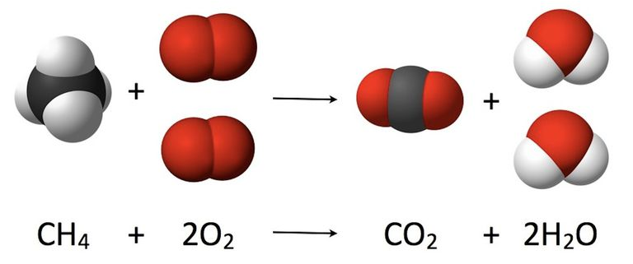
Skill Development / Guided Practice
Balancing Formula Equations
List the number of each type of element on both sides of the equation.
Choose an element that has unequal numbers
Add coefficients to make them equal and adjust the numbers of elements in the list.
Choose another element that has unequal numbers, add coefficients and adjust the list.
Continue until all elements have equal numbers.
Methane + Oxygen → Carbon dioxide + Water
CH₄ + O₂ → CO₂ + H₂O
2
2
C = 1
H = 4
O = 2
C = 1
H = 2
O = 3
4
4
4

Slide 17
Skill Development / Guided Practice
Balancing Formula Equations
List the number of each type of element on both sides of the equation.
Choose an element that has unequal numbers
Add coefficients to make them equal and adjust the numbers of elements in the list.
Choose another element that has unequal numbers, add coefficients and adjust the list.
Continue until all elements have equal numbers.
Aluminium + Chlorine → Aluminium chloride
Aℓ + Cℓ₂ → AℓCℓ₃
2
3
2
Aℓ = 1
Cℓ = 2
2
Aℓ = 1
Cℓ = 3
2
6
6

Slide 18



Relevance
Knowing how mass is conserved in a chemical reaction is important in industries that produce chemicals for our use, or in objects that use chemical reactions to produce energy.
Using balanced equations to understanding the ratios of reactants to products helps manufacturers to minimise waste materials.
For example:
Producing chemicals, such as fertilisers and household cleaners
Chemical reactions in batteries to produce energy
Chemical reactions in baking need the correct ratio of ingredients.
Optimising the ratio of fuel to oxygen in a car engine to make the engine more efficient

Slide 19
Skill Closure
Reminder: Balancing Formula Equations
List the number of each type of element on both sides of the equation. Choose an element that has unequal numbers Add coefficients to make them equal and adjust the numbers of elements in the list. Choose another element that has unequal numbers, add coefficients and adjust the list. Continue until all elements have equal numbers.
What is the Law of Conservation of Mass?
Skill Closure
Rewrite the equation below. Put a circle around the coefficients and a box around the subscripts.
CH₄ + 2O₂ → CO₂ + 2H₂O
Skill Closure
Balance the equation below.
Aluminium + Bromine → Aluminium bromide
Aℓ + Br₂ → AℓBr₃

Slide 20
Independent Practice
Complete the “Balancing Equations” worksheet.

